Slide 1
Spaceship Titanic
Testing stacking methods in a Kaggle competition
By Jordan Boswell

Slide 2
Introduction

Slide 3

Spaceship Titanic Competition
“Predict which passengers are transported to an alternate dimension”
A traveling spaceship collides with a spacetime anomaly, transporting some passengers to an alternate dimension
Predict which passengers were transported
Ongoing Kaggle competition set up by the Kaggle team, with synthetic data
Standard supervised learning task to predict a binary outcome using a tabular dataset
Data is split (by Kaggle) into a training set and a test set
Predictions made on the test set are uploaded and autograded
A leaderboard tracks the performance of your model relative to peers

Slide 4
Goals
Feature Engineering – Create meaningful features from the data
Data Imputation – Impute missing data optimally
Modeling – Build and test the performance of multiple classification models
Stacking – Utilize different stacking methods, and compare their performance with each other and with singular-model methods

Slide 5
Dataset
CSV files with 14 columns and 8693(train)/4277(test) rows
Roughly 2% missing data
Predictors:
PassengerId – Unique id for each passenger, consisting of a group id portion and an individual (within-group) portion.
HomePlanet – The planet the passenger departed from
Destination – The passenger’s destination planet
CryoSleep – Whether the passenger is in suspended animation or not
Cabin – The room, consisting of deck, side, and room number components
Age – The age in years of the passenger
VIP – Whether the passenger is a VIP or not
RoomService, FoodCourt, ShoppingMall, Spa, VRDeck – Amount of money spent at various locations
Name – The passenger’s full name
Response:
Transported – Whether the passenger was transported to an alternate dimension or not.

Slide 6
Exploratory Data Analysis

Slide 7
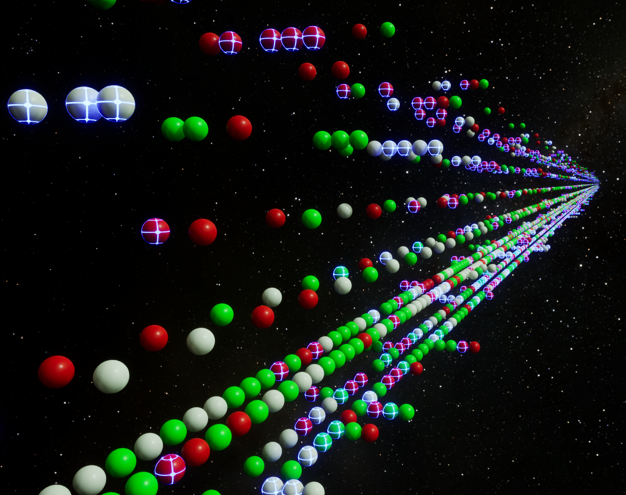
Real-Time 3d Visualization in Unreal Engine 5
Each sphere represents a passenger. Decks are represented by position on the up/down axis, sides are represented by the separation on the left/right axis, and cabin numbers are represented in order by position on the forward/backward axis. Red represents transported, green not transported, and grey is unknown (in the test set). Passengers with a luminous blue cross indicate cryosleep.
One takeaway from this visualization was the seemingly spatial clustering of transported passengers.

Slide 8
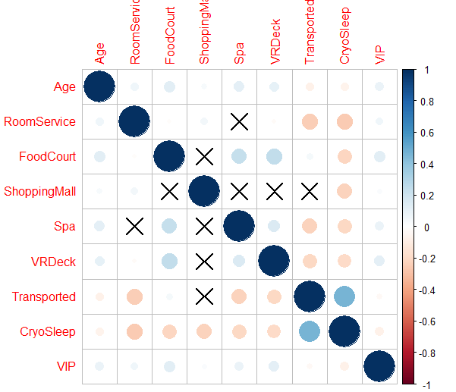
Correlation Analysis
Correlation plot of various predictors and the response. Various correlations exist. Notable are the positive correlations between Transported and the spending predictors, as well as the negative correlation between Transported and CryoSleep.

Slide 9
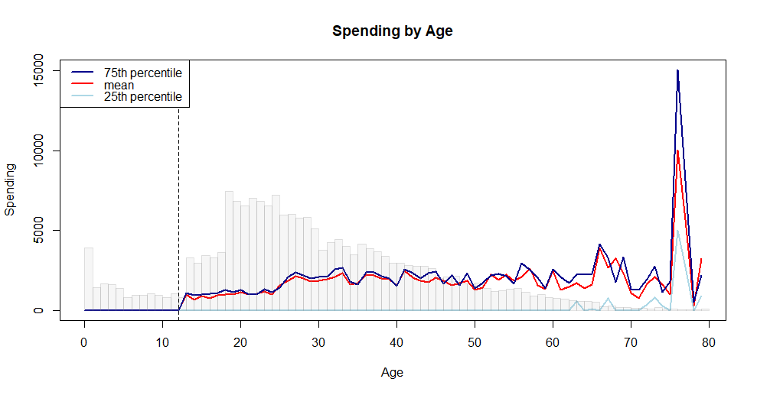
Exploration of Spending and Age
This clearly shows the distribution by age, the relationship between age and spending, and how children 12 and younger don’t spend money.

Slide 10
Patterns Found that Allow Manual Imputation of Some Missing Values
Passengers in cryosleep don’t spend any money
Children (Age <= 12) don’t spend any money
Some decks exclusively have passengers from certain home planets
People in the same group are on the same side of the ship
People in a group usually share the same cabin
Groups always have one home planet, but can have multiple destinations
No one from Earth has VIP status

Slide 11
Missing Data Imputation

Slide 12
Manual Imputation Based on Strong Patterns
Some EDA discovered patterns that held in all cases.
We manually imputed some missing values using those patterns.
The majority of the missing data still remained after this step.

Slide 13
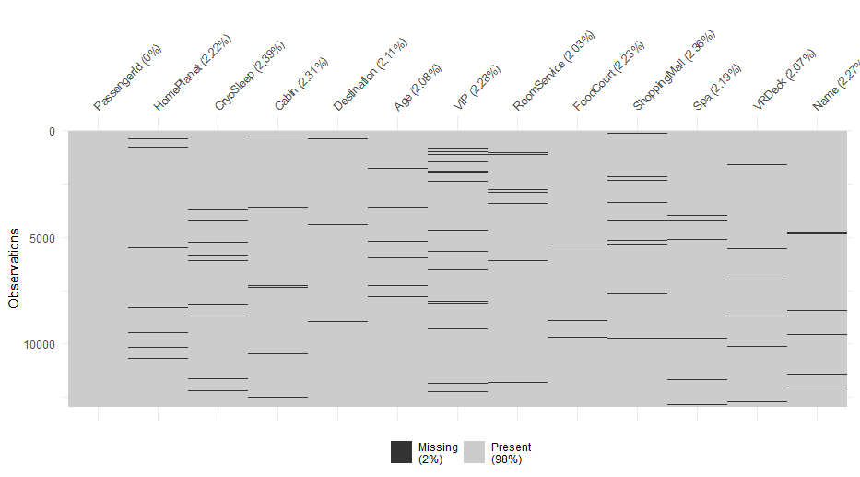
Analysis of Missing Data
Little’s MCAR test was used to test if the missing data were missing completely at random. The results were in favor of not rejecting the null hypothesis, and thus favored the assumption that the missing data were missing completely at random (p-value of 0.47). The MCAR property allows the imputation of data without introducing bias.

Slide 14
Non-Parametric Missing Value Imputation Using Random Forests
The missForest R library was used to impute the remaining missing data
The training and testing data were stacked together, and the response variable was removed
The combined data set was fed into missForest for imputation
Multiple iterations of imputation were performed to produce a final, complete dataset
For the initial iteration, mean and mode imputation was performed.
For each subsequent iteration, for each column, a random forest of 1500 trees was fit with that column as the response and the rest as the predictors, and then that column’s cells that originally had missing data were predicted.
Iterations continued until the predictions converged (didn’t change much between iterations)

Slide 15
Feature Engineering

Slide 16
Basic Column Creation
The cabin was parsed and split into three columns:
Deck – The deck letter
Side – The side of the ship; either S (starboard) or P (port)
Num – The room number
PassengerId was split into IID (individual) and GID (group) components
The spending columns were added to create a Spending column
A Boolean HasSpent column was created
The name was split into FirstName and LastName columns
A Boolean IsChild column was created to indicate if passengers were 12 or younger

Slide 17
Group Columns
Each group was analyzed and new columns created
Group size
Number of group members transported
Number of group members in cryosleep
Number of cabins occupied by the group
Etc.

Slide 18
Cabin Columns
Similarly, cabins were analyzed and new cabin-based columns created
Cabin size
Number of people in the cabin transported
Etc.
Further columns were created based on the passenger’s surrounding cabins
E.g. Side neighbor cabin’s size
The goal was to create proximity-based columns to aid the machine learning models in finding spatial clusters of transported passengers.

Slide 19
Column Data Type Preparation
Some models require data to have certain data types
In order to comply with all models, the data were transformed into numeric variables
Categorical variables were transformed into binary 1/0 dummy variables
Integer variables were transformed into continuous variables (R’s numeric type)

Slide 20
Modeling Methodology

Slide 21
Modeling Methodology
Three base models were tuned using 10-fold cross validation on the training data
LASSO logistic regression
Random forest
XGBoost
Stacking models were created by taking the out-of-fold predictions of those same three models, and using them as input to a logistic regression meta model
Meta model with raw probability predictions as its predictor variables
Meta model with Boolean predictions as its predictor variables

Slide 22
Base Models
R’s glmnet, randomForest, and XGBoost libraries were used for LASSO logistic regression, random forest, and gradient boosting models, respectively
Each model had 200 sets of hyperparameters generated using a latin hypercube space-filling method
The 600 total models underwent 10-fold cross-validation to find the best hyperparameters
LASSO hyperparameters – L1 penalty
Random forest hyperparameters – Number of trees, number of sampled predictors, and minimum node size
XGBoost hyperparameters – Number of trees, number of sampled predictors, minimum node size, tree depth, learning rate, minimum loss reduction, and the sample size proportion
The most accurate model from each class was chosen, refit on the whole training data, and used to predict the test data.

Slide 23
Meta Models
Out-of-sample predictions were gathered from the results of the best base models’ 10-fold cross-validation processes
Those results were used to create six new predictors
Two for each of the selected base models – probability and Boolean predictions
A logistic regression model was fit on the three probability predictions, with Transported as the response. Another was fit on the Boolean predictions
The base models’ predictions of on the test set were used as input to produce the meta models’ final predictions for the test set.

Slide 24
Results

Slide 25
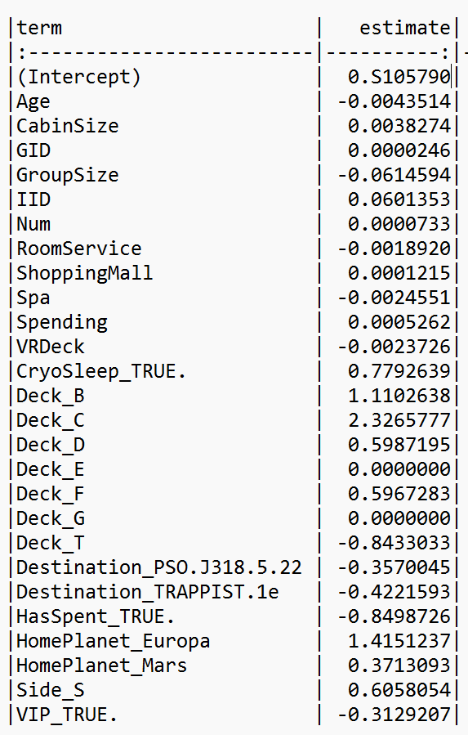
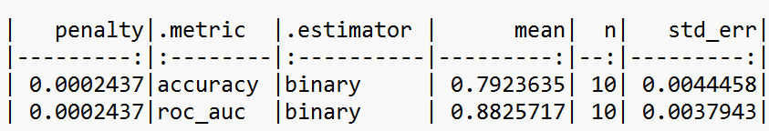
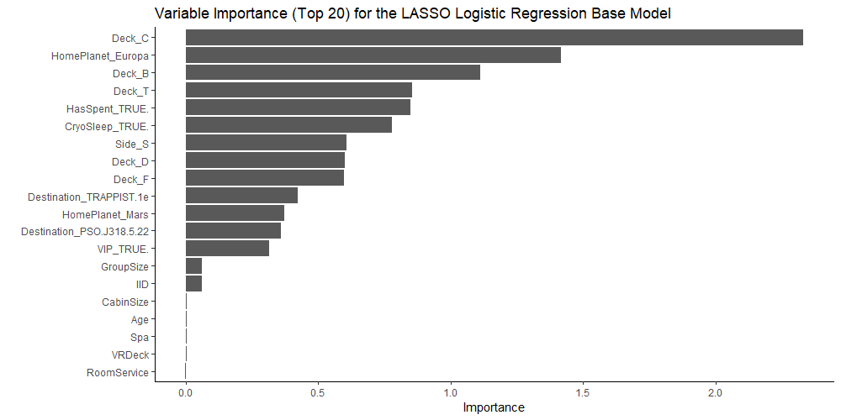
LASSO Logistic Regression

Slide 26
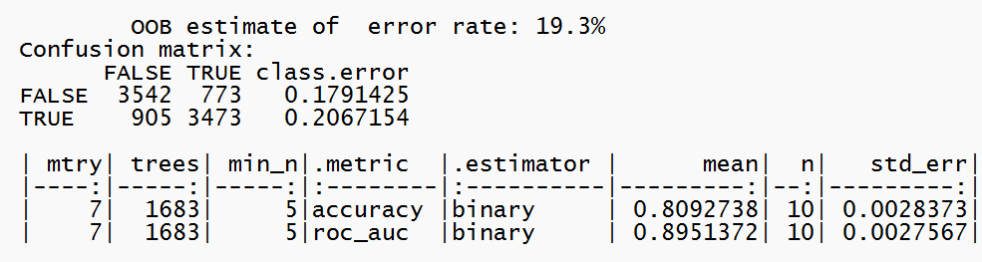
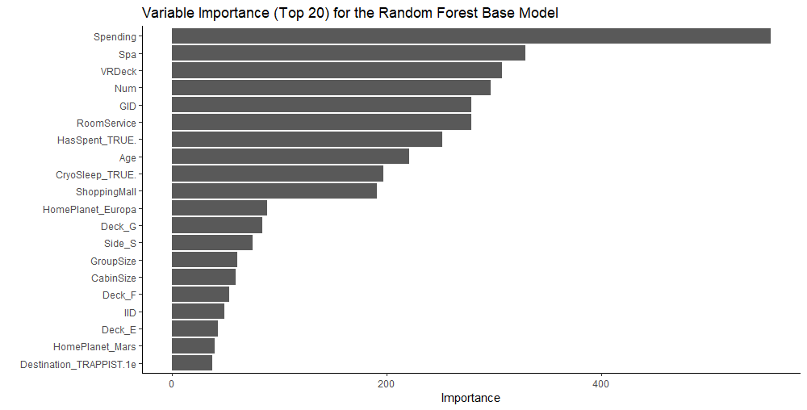
Random Forest

Slide 27

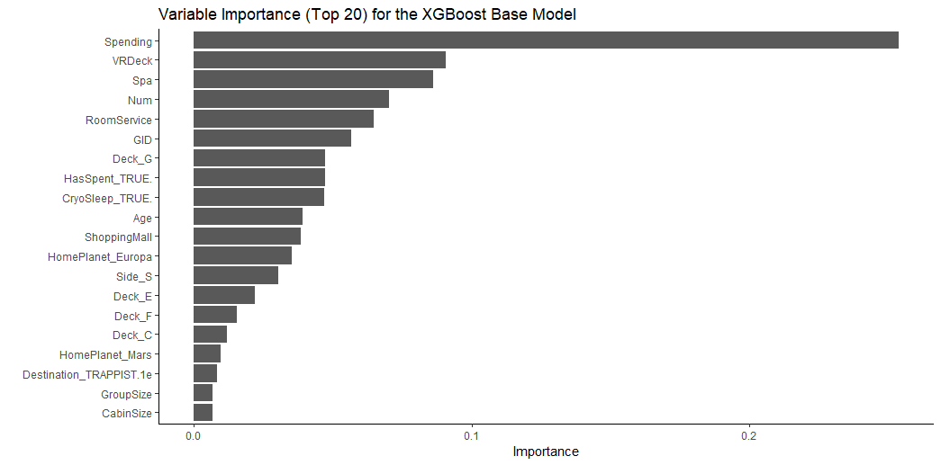
XGBoost

Slide 28
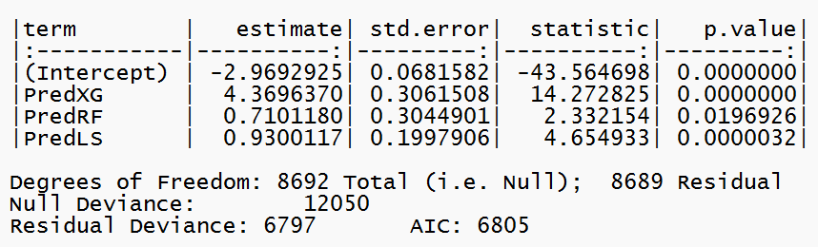
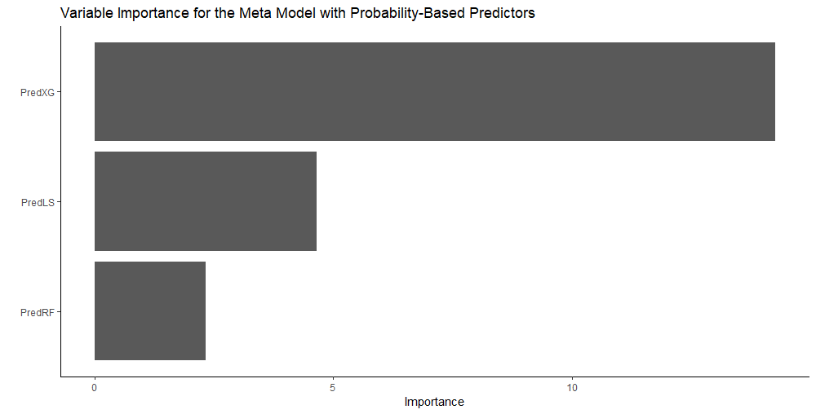
Meta Model with Probability Predictors

Slide 29
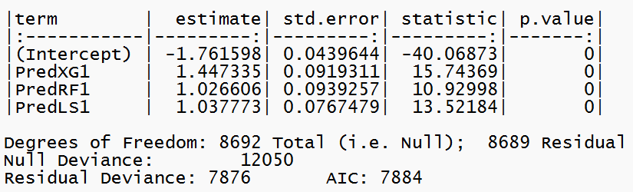
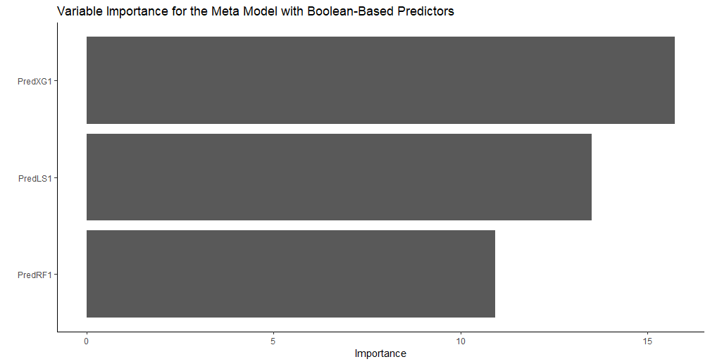
Meta Model with Boolean Predictors

Slide 30
Test Set Classification Accuracy
LASSO | Random Forest | XGBoost | Meta (Prob) | Meta (Bool)
79.73% | 79.50% | 80.20% | 80.43% | 80.22%
The Meta (Prob) performance achieved position 398 out of 2268 on the competition’s leaderboard

Slide 31
Discussion

Slide 32
Model Performance
XGBoost was the best performing base model, which is in line with empirical results shown in other competitions and studies.
LASSO performed well and valued predictors differently than the other two base models. The different “perspective” that LASSO offered may have contributed to the effectiveness of the meta models.
The probability-based meta model performed better than the Boolean-based one. This makes sense since converted a numeric probability to a Boolean value results in significant data loss.

Slide 33
Future Extensions
Add some or all of the original predictors to the set of predictors for the meta models
Build different stacking models by varying the training and cross-validation approaches
Add additional base models
BART
NNs
XGBoost models with different hyperparameters
Use sequential hyperparameter search instead of a fixed starting set of hyperparameters to test

Slide 34
End

